Slide 1

This unit will cover writing documents in the functional arena.
Objectives:
At the end of this unit, you should be able to:
Define Functional writing
Identify various functional writing arenas and documents thereof
Write a number of functional documents
Learn and master the principles and guidelines that govern functional writing

Slide 2

It is the process of inscribing characters on a medium designed for a capable / particular function (use).
It is an act of creating written works adapted for a particular function.

Slide 3

List any functional documents in the writing arena.
These are found in the following areas:
Employment field and or Academic field, office business
Application Letter,/cover letter/Motivational letter
Curriculum Vitae/Résumé
Letter of invitation to interview
Recommendation/ reference letter
Acceptance letter
Refusal letter
Resignation letter
Personal Statement/ Statement of Purpose

Slide 4

These are multiple and include the following:
Business Reports
Memoranda/ Memo
Circulars
Request letters
Adjustment/ Complaint letter
Inquiry letters
Warning letters
Meeting minutes

Slide 5

An important part of the job seeking is writing letters and compiling other related documents. Because you will definitely not be the only
person/ applicant seeking that job, your job
related writing will require that you write
about yourself convincingly enough to persuade the prospective employer that you are the best candidate for the job.

Slide 6

It is that document that introduces you to your prospective employer. It plays a part in qualifying you into the organisation/company.
As such, your application/ cover letter should be written in a standard format thus.
If your application letter is to qualify you into the job in any organisation ; it must have the following features:

Slide 7

These are basically three;
Full block format
Modified form of layout
Indented form of layout
Full block Format (layout )
This form of layout is extremely popular. It makes the letter look attractive, elegant and efficient.
In this form, each part of letter is aligned to the left margin. All parts of the letter – dates, sender’s address, subject, salutation, complimentary close, and signature are all placed against the left hand margin of the page.

Slide 8

With this layout, various parts are distributed on the page. Some are on the left, some in the middle and some on the right. The sender’s address and date may be placed on the right margin. Insider address, salutation and each paragraph may be aligned to the left. Complimentary close and signature may be centered or aligned to right
This method is considered conservative and it is not very popular.

Slide 9

Indenting refers to set back or beginning in line farther from the margin to mark a new paragraph. The layout here is in modified block form except that the start of each paragraph starts a few spaces away from the margin. The form makes the letter some what clumsy and has gone out of the style.
*See sample illustrative letters attached respectively*

Slide 10

How many section has an application letter?.......
A-
B-
C-
D-
E-
F-
G-
H-
I-
J-

Slide 11

Begin the application letter with your address and Telephone number
Follow with the date of application
Write the title and address of the addressee
Salutation
Subject line/ Terms of reference
Introductory line
Body content
Attachments
Closure
Complementary close/Sign off

Slide 12

Check out any samples that can help in the learning process.
Rules to follow when writing job applications.
Use short sentences
Use a simple language
Be brief, direct and factual
Try to be as clear as possible
Briefly state your personality suitable to the job.

Slide 13
Note that in your application letter, you should endeavour to write and suit it to the requirements of the job.
This is bse; when calling for applications, most employers state the requirements, the ideal or suitable candidate should have.

Slide 14

A Curriculum Vitae is a summary of the
information regarding an applicant’s education
qualification, working experience and other
details.
It is that document that gets the applicant invited
for an interview.

Slide 15

Chronological CV
Targeted CV/Functional
Executive CV
Educational CV
When writing a CV, one should consider the different sections that make it up. Different
people write their CV’s differently depending on the purpose and positions on target.

Slide 16

The first item is the title – Curriculum vitae CV in capital letters.
Bio data/Background Info/ Details: (capitalised and bold) with the following elements.
Names
Address
Telephone
Email
Sex
Date of birth
Marital Status
Nationality

Slide 17

When compiling information for this section begin with the latest qualification, depicting (period) year, institution and Award/ Qualifications.
Mention only important qualifications and if you have very many write other (Minor) ones under the subheading.
Other qualifications – highlight under the same format.

Slide 18

Begin with the latest and relevant work experience under
the format. Under this section, the aspect of
responsibilities can also be described i.e. the nature of
activities one was involved in. You must use strong active
verbs/adjectives e.g. Supervised, introduced, initiated,
controlled e.t.c
5. Hobbies / Interest (Highlight and Bold)
Mention hobbies that are relevant and to the job applied
for ones that imply team work , creativity, hard work
as opposed to those that encourage vices.

Slide 19

Briefly describe your personality particularly your positive attributes that make you the ideal candidate for the job e.g. Am a social, outgoing person who can get on with people in any situation. I am reliable, hardworking and trustworthy.
6. Referees (Highlight and Bold)
Give the name and full addresses of relevant/Competent referees who are socially

Slide 20

Start with heading e.g. CURRICULUM VITAE in capital letters
Write your skills and competence e.g. Computer literacy skills, communication skills, etc

Slide 21
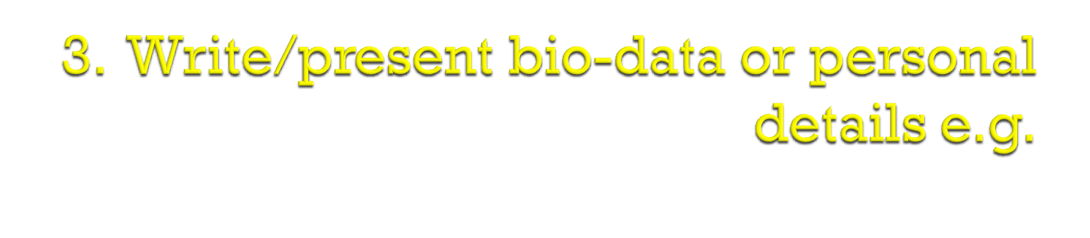
Name:
Address:
Sex:
Marital status:
Nationality:

Slide 22
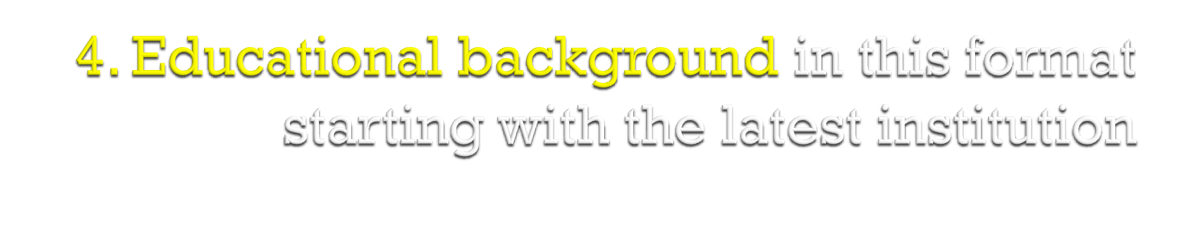
Year Institution Award /Qualification
2002-2003 Makerere Univ. Bsc.Comp Sci.
5. Working Experience in this format
Year Organisation Position
2004 to date Bank of Uganda Systems Adm
6. Languages Spoken
Indicate the languages you know and how fluent you are in those languages

Slide 23

Write your hobbies e.g.
Football
Netball
8. Referees
Mention at least three persons. State their names, titles and name of organisations where thy work and their telephone numbers.

Slide 24

Every time you apply for a different job, you should revise and edit your CV to put in relevant information that suits that particular job e.g. A change in referees, adjusting to suitable / relevant work experience, emphasising particular qualifications since different jobs demand different requirements e.g.

Slide 25

This is a formal means of written communication that is used in sending messages within an organisation or company concerning a variety of issues.
Purposes of a Memo
To inform members of decision actions
To request decision actions
To remind some one of action required
To provide information of any kind

Slide 26

Most organisations have these memos already designed with the company logo.
There are five main areas that apply to memo writing. They are;
a) Title (Memo)
b) Audience /receiver
c) Sender/ source
d) Date; This is date of release/ circulating the memo
e) Subject ; this is the gist of the message. This is where the key points are captured by giving the info in a logical order

Slide 27

Make a plan first before writing memos
Remember to point our the 5 point plan
Use simple, clear language the reader will understand
Give your memo an appropriate subject heading
Avoid unnecessary expressions like thank you and regards
Use bullets where applicable
Don’t include a salutation or complimentary close on memos
Sign your memo in the usual way to authenticate it at the point of from; source.

Slide 28

Since a memo is usually used as written communication within an organisation there is no need for salutation, complementary close. Do not repeat the sources’ name(from) after the subject matter like it is with letters.
Titles are not needed in the To and Fro sections.
To be courteous however, the title may be used in the To (Receiver) section e.g. To all Distinguished members, To Mr. ,Dr.

Slide 29

MEMO
To: All B.Sc. Computer Sc & Dip. Comp. Sc and Information Technology
From: Lecturer, Comm. Skills
Date: 22nd October 2009
Subject: Test two schedule
You are all reminded that there will be a second set of communication skills to be done in the three weeks time. Ensure that you have prepared adequately and pay all the dues as required to avoid inconveniences.

Slide 30

Definition
A report is an informative written document that is written after research, investigation or critical study or observation.
A business report is an impartial objective planned presentation of facts to one or more persons for a specific business purpose. It may be defined as communication of information and services from one person who has collected and studied facts to someone who needs to make decisions.
Usually a report contains details that can’t be found in normal letters and memos.

Slide 31

Reports help in decision making
Efficient way of disseminating complex info. Systematically to a large number of people in business
Reports act as a permanent record
Present suggestions on ways in which a situation may be improved
For further funding e.g. Global fund report
For future plans
Identify the weaknesses of the company
Assessment of the performance appraisals
To make conclusions and interpret the information
For company literature review( source of reference)
Evaluate and assess the progress of the company

Slide 32

A report will achieve its objectives if it provides the necessary and sufficient balance of the following characteristics relating to the specific audience and situation.
Content criteria
Accuracy
Brevity
Clarity
Design(Organisation, logic progression and layout)
Emphasis(of the most important points)
These criteria apply not only to the content but also to
the use of language, the graphic devices and overall
Structure.

Slide 33

Preliminary sections
Title
Terms of reference
Synopsis
Table of contents
List of illustrations
Glossary
Main body – Introduction, Main content part,(Literature review, methodology, data analysis and presentation of findings)
Conclusions, recommendations, List of references, Bibliography, Appendices

Slide 34

Routine reports
These are reports that are made on a daily basis example
Sales visits
Managers’ reports on the work of their departments
Equipment and maintenance reports
Progress reports
Safety reports
Accident reports
Interim reports
Special reports
These are reports written in response to requests for specific information, for market research, regarding a change of policy, or made after research and investigation. Examples include; Proposal reports, feasibility reports, Investigative reports

Slide 35

FORMAL REPORTS
Formal reports are usually written by a committee or group of people after fairly detailed investigation or research
This is the structure of a business report
Heading
There should be two headings to a report, the name of the company, and the report ………….
Term of reference
This section should state exactly why the report is written. Why are you writing the report? What was requested? Who requested it? When were you asked to do it?
Procedure
Give a brief description of the method used to collect the information. Perhaps interviews were held, visits made, questionnaires issued? Use numbered points if appropriate.

Slide 36
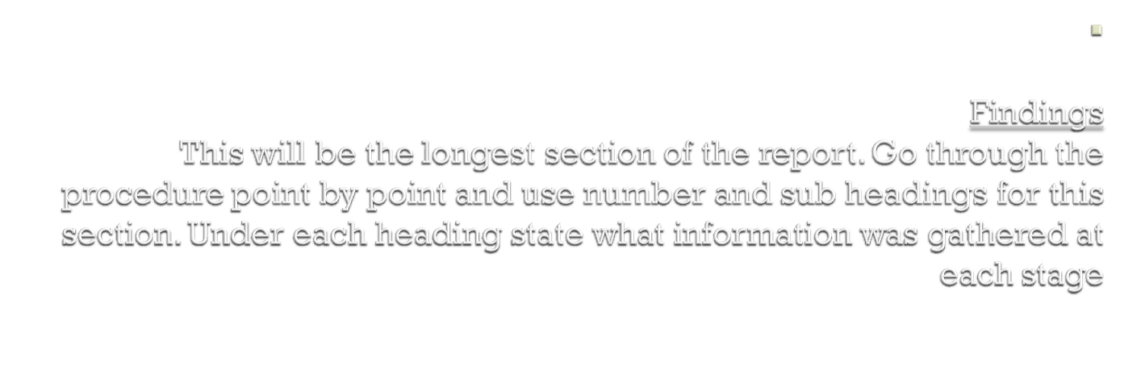
Conclusion
No new fact must be introduced in this section. You must look at the findings and state the logical implication of them. What can you infer or conclude from the findings
Recommendations
Again no new facts must be introduced here. On the basis of information presented in findings and conclusions, make some suggestions for action. Remember that the writer of the report cant make report decisions- he or she only suggests what action should be taken.
Closing section
A report should be signed and there should be a name and title shown at the foot plus the date the report was written

Slide 37

Hass Petroleum Company
Report on complaints about poor customer service
Terms of reference
To investigate reports about poor customer service provided by the staff and make recommendations, as requested by Mr. Abdillahi Mansour.
Procedure
An interview was held with Mr. Hussein Gabdi, the sales manager on 2/11/07
Interviews were held with a cross section of customers (50) who we provide to our services
Findings
Interview with Mr. Hussein Gabdi, (the sales manager)
…………………………………………………………………………………………………………………………………………………………………………………………………………

Slide 38

Conclusions
1……………………………………………………………………………
2……………………………………………………………………………
Recommendations
1……………………………………………………………………………
2……………………………………………………………………………
Sharif Abdisamad
Business administration officer

